Slide 1


Fit or Fail a revolutionary fitness game
https://fit-or-fail.herokuapp.com/
Christian Sauls
Travis Stewart
Josh Shevitz
Kafui D
Adamma Newman

Slide 2
Purpose of The Project
To create a fun, interactive learning experience that educates teens on consistent healthy lifestyle decisions such as diet and exercise
US Dept of Health and Human Services (DHHS) – Teens today are more likely to develop a sustained interest in a healthy, active lifestyle if they are provided with some type of technology-based “game-like” tool to stimulate their interest in the areas.
Mobile-first design
Focus group: High school aged teens, eventually expanding to children of all ages

Slide 3
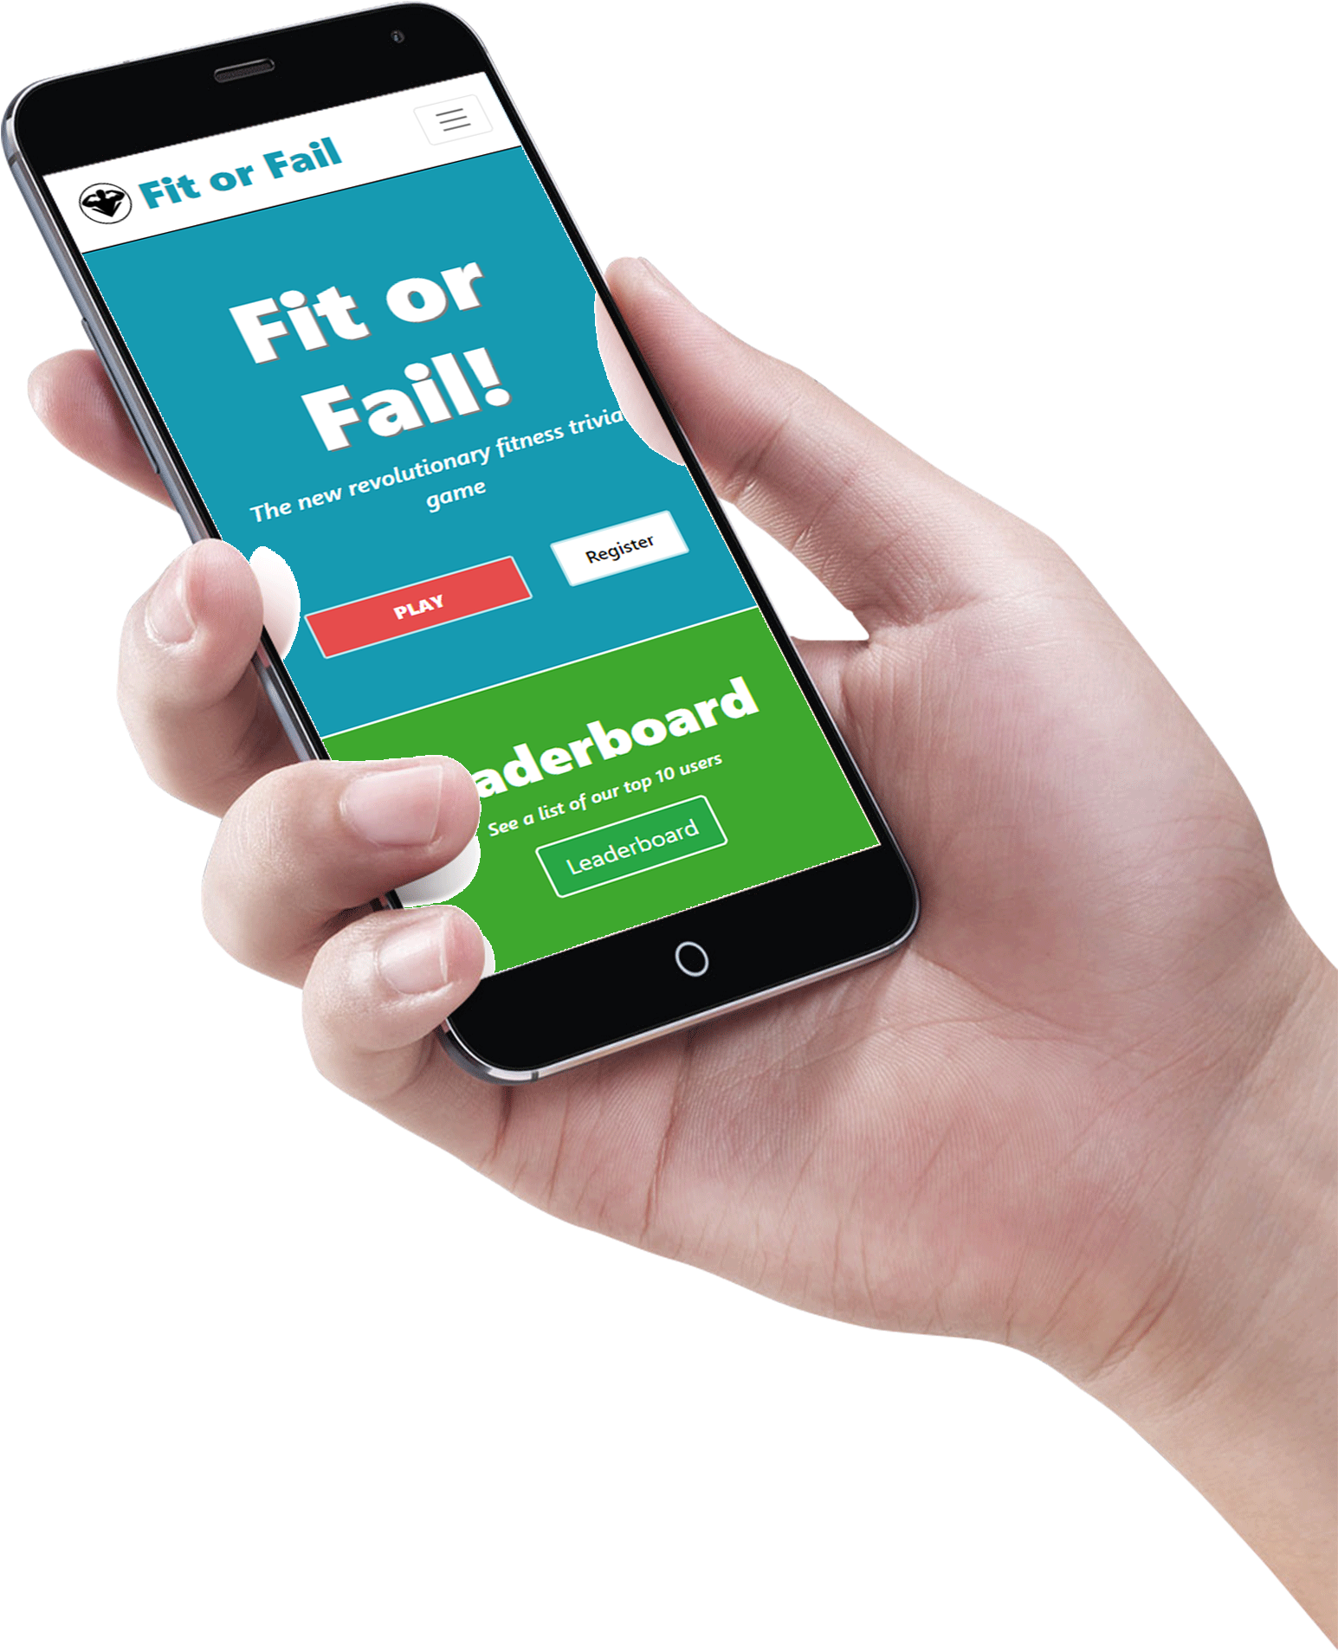
Requirements
Prioritized support for mobile devices
Should still be compatible with all other devices (desktops, tablets, etc.)
A game designed to educate about healthy lifestyle choices
Single, team, and multi-player modes
Facilitate advertising and the ability to receive donations
Parents/guardians ability to monitor a child’s progress
Allow appropriate government officials and other designated personnel to contribute input as well as monitor the progress of all teens
Register accounts for children/teens

Slide 4
About Our Game
Online multiplayer fitness trivia game
Game modes:
Solo – Play by yourself, answering a handful of randomly-chosen questions
Online – Play for points competitively against other individuals in a Kahoot!-style game
Users can create and join Teams
User accounts store data for points, correct answer rate, wins, and more
Users in a Team contribute their earnings to their Team’s statistics as well

Slide 5




Technologies Used
Front end
React
Next.js
JavaScript
HTML/CSS in JS (React)
Bootstrap
Back end
MongoDB (mongoose)
Node/Express.js
JSON Web Tokens
Domain/Hosting provider
Heroku
Collaboration
GitHub/Git
GroupMe
Google Hangouts
Miscellaneous
Stripe
Various npm packages (23 in total)

Slide 6
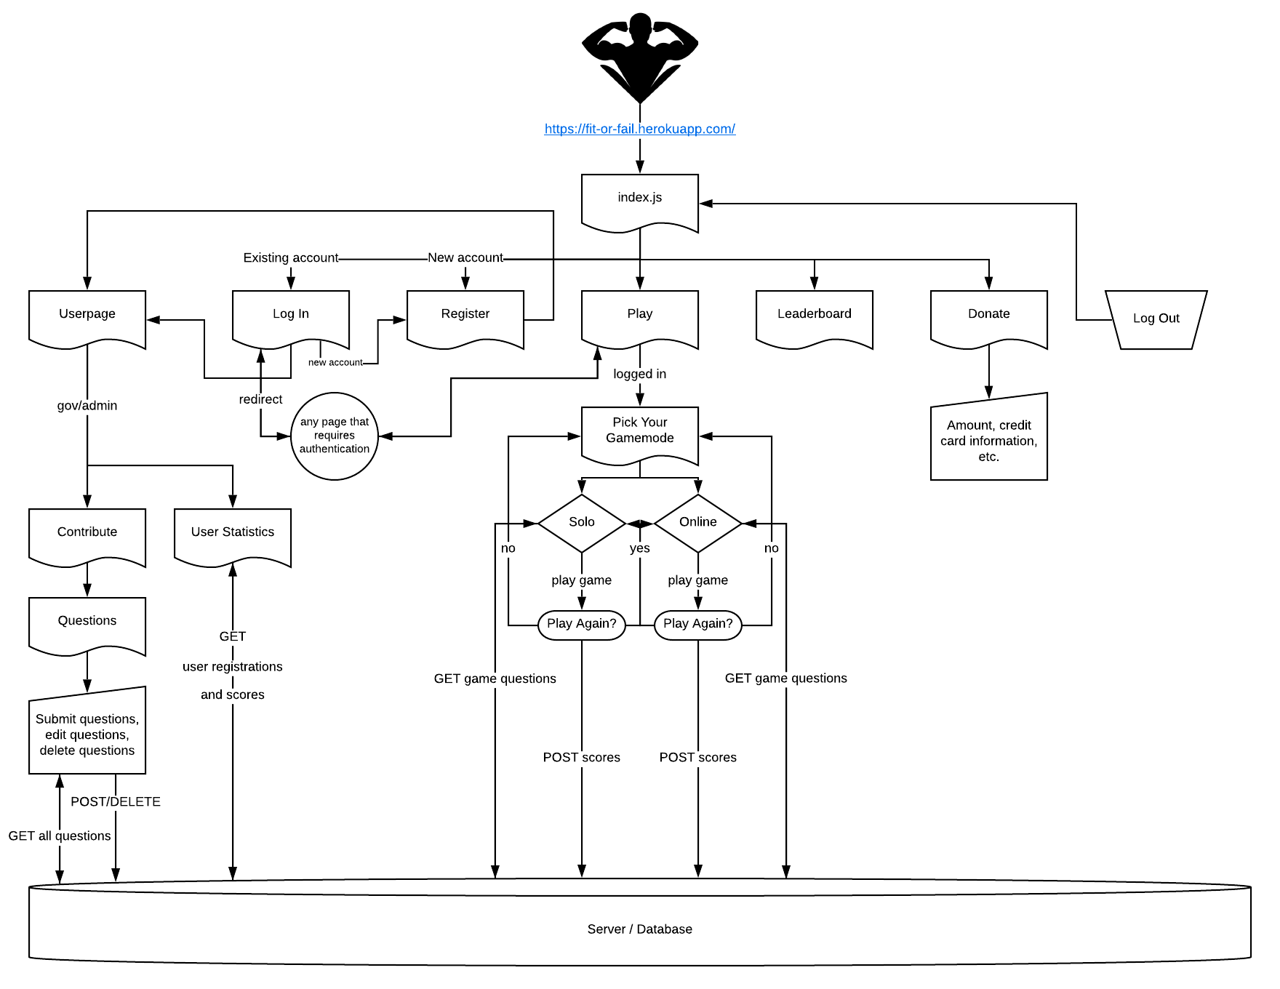
Website layout

Slide 7
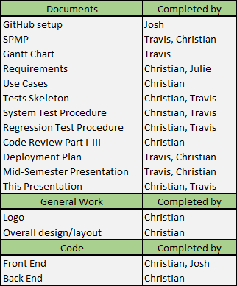
Roles and Contributions
Christian Sauls – Entire backend and frontend, designer, secondary documenter, coordinator
Travis Stewart – Primary documenter
Josh Shevitz – Secondary frontend/design, POC, coordinator
Kafui D – Updated the Requirements document and made the old version of the game selection page
Adamma Newman – Made the old non-functional versions of the solo game and “contribute questions” pages

Slide 8

Live Presentation
https://fit-or-fail.herokuapp.com/

Slide 9
Next Steps
Live multiplayer mode
Kahoot!
User Teams
Continue to add questions to the game
Separation of question categories; different game “themes”
Ex: Healthy eating, muscle development, etc.
Full donations implementation
Work with advertisers to curate appropriate advertising and consistent funding
System for ads to be reviewed by government officials before they’re posted
New features coming in the future, such as:
Custom profile pictures
Editable userpages
Bio, background color
Graph of stats over time
Friends list
Donor role
Detailed site-wide statistics, categorized by month
Improved API
Fix abuse potential
General site maintenance and testing
Add animations throughout for a smoother user experience
More diverse typography
Additional mobile optimizations where needed

Slide 10


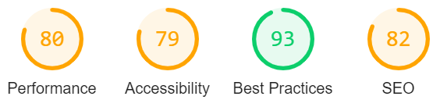

What Sets This Product Apart
Mobile-first, garnering the most traffic, especially for our target demographic
React + Next.js
Not just another bulky create-react-app
Server-Side Rendering and pre-rendering to static HTML
Pages delivered blazingly fast; place static files on the edge (CDN)
SEO-friendly
Future-proof in terms of web development trends
One of the most popular React frameworks, continuous growth
Netflix, Tencent, Hulu, GitHub, Twitch, Uber, Starbucks, Docker, Coinbase…
Just received $21M Series A Funding
Deployment of site is simple and fast
Entirely custom
Written in the languages that developers already know and love
MERN stack
Not restricted to the limited capabilities of 3rd-party services
Easily modifiable and extensible

Slide 11

Thank You
Questions?

